Slide 1
Risk Management
Faisal Iradat

Slide 2
Assets, Threats, Vulnerabilities, and Risks
An asset is composed of the people, property, and information within our organization (anything of value).
A threat is anything that can exploit a vulnerability, intentionally or accidentally, and obtain, damage, or destroy an asset.
A vulnerability is a weakness of an asset that can be exploited by a threat.
A risk is a potential for loss, damage, or destruction of an asset when a threat exploits a vulnerability.
Risk Equation: Risk = Threat x Vulnerability

Slide 3
Risk Equation
Risk = Threat × Vulnerability × Impact
Threat: The potential for a cyber incident to occur, such as hackers, malware, or insider threats.
Vulnerability: Weaknesses in systems or processes that can be exploited, like outdated software or unpatched systems.
Impact: The consequences of a successful attack, including financial loss, data breach, or reputation damage.
By addressing these three factors, organizations can manage and mitigate their overall cybersecurity risk.

Slide 4
Scenario 1: Phishing Attack
Threat: Cybercriminals send phishing emails to employees, attempting to steal login credentials.
Vulnerability: Weak email filtering and untrained staff on identifying phishing attempts.
Impact: If credentials are stolen, sensitive corporate data could be exposed, leading to significant financial loss and reputational damage.

Slide 5
Scenario 2: Unpatched Software
Threat: Hackers exploit a known vulnerability in outdated server software.
Vulnerability: The company's server is not updated regularly.
Impact: A breach could compromise customer data, resulting in legal and financial consequences.

Slide 6
Scenario 3: Insider Threat
Threat: A disgruntled employee intentionally leaks confidential information.
Vulnerability: Lack of internal monitoring or insufficient access control.
Impact: Loss of intellectual property and potential damage to the company's competitive position.

Slide 7
Introduction to Risk Management
The Basic Definition
Risk Management is the process of identifying, assessing, monitoring and limiting risk to an acceptable level.
Expanded Definition
Risk Management provides a systematic and repeatable process for identifying, assessing, prioritizing, monitoring, tracking, and regularly communicating the status of threats, risks, issues, and actions items to management, stakeholders, and executive-level decision-makers.
Primary Goal
Risks are reduced to a level that an organization will accept.

Slide 8
Risk Assessment
A risk assessment, where risks are identified and assessed, is the first step in the risk management process.
Example Risk Assessment Process:
Identify and categorize your risks
Assess each risk’s probability and impact
Assign each risk a risk score and prioritize accordingly
Respond Accordingly

Slide 9
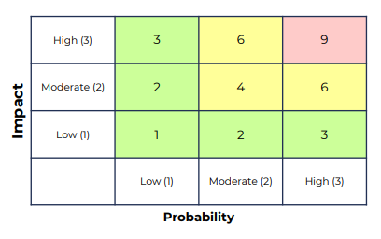
Qualitative Risk Assessment
Risk Assessment Score = Probability x Impact
Probability: The likelihood that a risk will occur.
Impact: The negative impact of a risk if it occurs.
Probability and impact are given numbers to help categorize the severity of a risk, if realized.
Based on the overall severity of risk, we can choose the appropriate risk response measure.

Slide 10
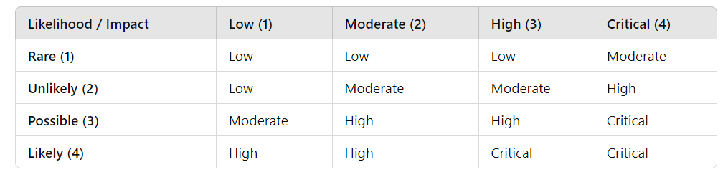
Risk Matrix for Risk = Threat × Vulnerability × Impact
Risk Value Interpretation:
0.0 - 0.2: Low Risk
0.21 - 0.4: Moderate Risk
0.41 - 0.6: Moderate-High Risk
0.61 and above: High Risk

Slide 11
Risk Response Categories
Avoidance: The process of eliminating a risk by not engaging in an activity. We avoid a risk by eliminating its source altogether.
Acceptance: Accepting an identified risk, meaning no action will be taken when a risk assessment score is low.
Mitigation: The process of taking steps to minimize the impact of a risk.
Transference: Transferring the responsibility of a risk to a third party, such as insurance.
Residual Risk: The risk that remains when after risk mitigation or transference activities have taken place.

Slide 12
Exploring Risks and Threats
Risks
Monetary
Reputation
Loss of Asset
Intellectual Property
Legal
Threats
Natural
Unintentional
Intentional

Slide 13
Qualitative vs. Quantitative Risk Analysis
Qualitative and quantitative risk analysis are two different methods for analyzing risk:
Qualitative : More Subjective
Quantitative : More Objective

Slide 14
Quantitative Risk Analysis Equation
Risk=Single Loss Expectancy (SLE)×Annual Rate of Occurrence (ARO)
Single Loss Expectancy (SLE) is calculated as:
SLE=Asset Value (AV)×Exposure Factor (EF)
Annual Rate of Occurrence (ARO) is the estimated frequency of the risk event occurring within a year.
This equation helps organizations quantify potential losses from risks, aiding in decision-making and resource allocation.

Slide 15
Quantitative Risk Analysis Components
Your data center is valued at $500,000. If there is a major earthquake, you estimate 25% of the data center will be damaged. Your risk team estimates there will be a major earthquake once every ten years.
Would it be prudent to purchase earthquake insurance with an annual cost of $25,000?

Slide 16
Attack Surface Analysis
An attack surface is a vulnerability. It’s any way an attacker can gain access to pose a security risk.
There are three common attack surfaces:
Application
Network
User
The greater the overall attack surface, the greater the overall risk.

Slide 17
Application Attack Surface
When analyzing our applications for attack surfaces, we’ll commonly look at:
The Amount of Code
Data Inputs
System Services
Network Communication Ports

Slide 18
Network Attack Surface
When analyzing our network for attack surfaces, we’ll commonly look at:
Overall Network Design
Placement of Mission Critical Servers & Systems
Placement & Configuration of Network Firewalls
Other Security-Related Devices & Services: IDS, IPS, VPN, etc.

Slide 19
User Attack Surface
When analyzing our users for attack surfaces, we’ll commonly look at:
Effectiveness of Policies, Procedures and Training
Risk of Social Engineering
Potential for Human Error
Risk of Malicious Behavior

